Slide 1
Scottish LGPS
2015
Dave Watson
Head of Bargaining and Campaigns
UNISON Scotland

Slide 2
Background
UK Public Service Pensions Act
CARE scheme
Pension age linked to state pension age
Cost capping
Scottish LGPS 2015
Focus on main benefit – accrual rate
Keep contributions stable - Pay restraint, economy, NI contributions 2016
Strengthen governance of funds

Slide 3
Scottish LGPS 2015
Final salary to CARE scheme
Generally fairer - spreads scheme benefits
Accrual Rate – 60ths to 49ths
E&W comparison - mortality rate v ill health, death in service & age profile
Contributions unchanged
Banding not cliff edge. P/T based on actual pay not nominal F/T
Pensionable pay – P/T add hours not overtime
50/50 option – bring in 25% workforce, review 2017
Civil partners as married and cohabiters don’t nominate
Post April 2015 – transitional protections
Notes:
Transitional protections
Pensions in payment or deferred no change in benefits
Rule of 85 transitional protection to 2020 retained
Final salary at April 2015. Pension on last year of service
Underpin for members within 10 yrs retirement at 2012
Accrued benefits pre-2015 & CARE added together and compared with what would have got under final salary. Better of two

Slide 4
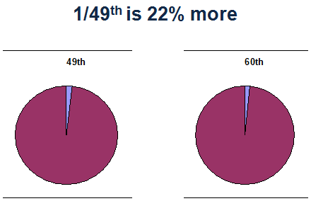

Slide 5
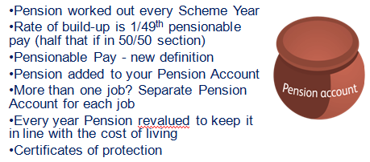
How is the new pension worked out?

Slide 6
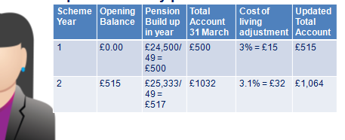
Worked example

Slide 7
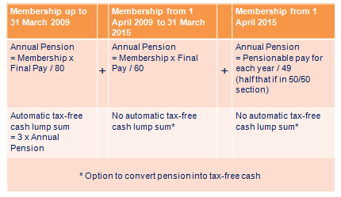
How pension calculated on retirement

Slide 8
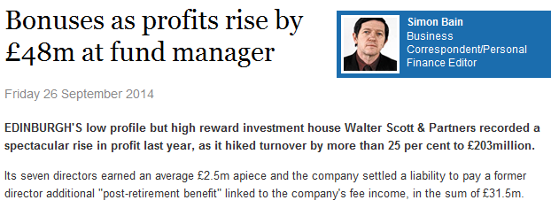
Why governance matters

Slide 9
Governance
Scheme Advisory Board
Statutory SLOGPAG
Review fund structure
IORP and separation from lead local authorities
Number of funds in Scotland or shared services to cut costs
Cost control – 2% cap
Pension Board at fund level
UNISON reps. Step up scrutiny

Slide 10
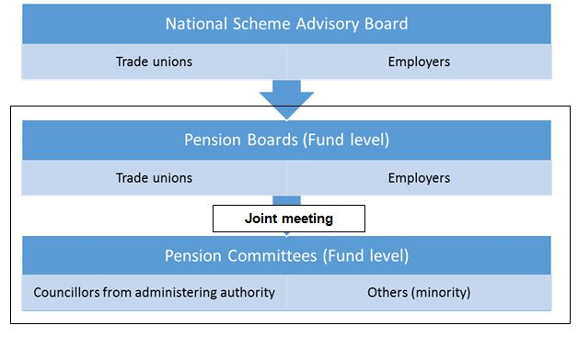
Hybrid Solution

Slide 11
Next Steps
Scheme regulations going through Scottish Parliament
Governance
Model constitution and regulations
Agree pension board membership and elect UNISON reps
Train and support
Start work on structural review - IORP interpretation impact
Implementation April 2015
Joint communications – UNISON Scottish Pensions Bulletin
Future
State pension changes – NI increase 2016 (1.4%. 3.4% employers)
Revaluations

Slide 12
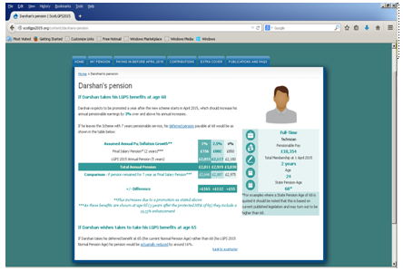
More information
www.scotlgps2015.org
www.unison-scotland.org.uk/pensions/index.html

